Slide 1
PIPELINING
Pipelining is a technique of decomposing a sequential process into sub-operations, with each sub-process being executed in a segment that operates concurrently with all other segment.

Slide 2
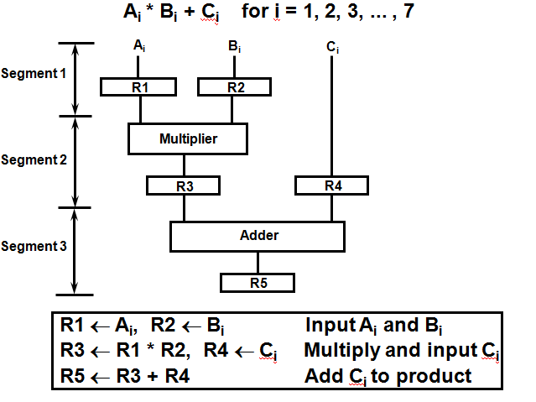
Example for Pipeline Processing

Slide 3
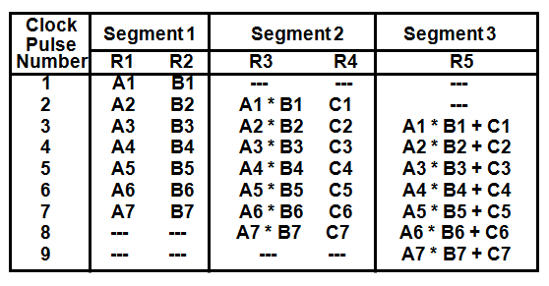
Operations in each pipeline stage

Slide 4
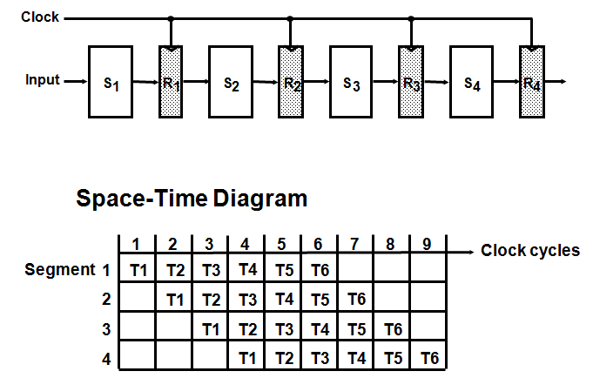
General Four-Segment Pipeline

Slide 5
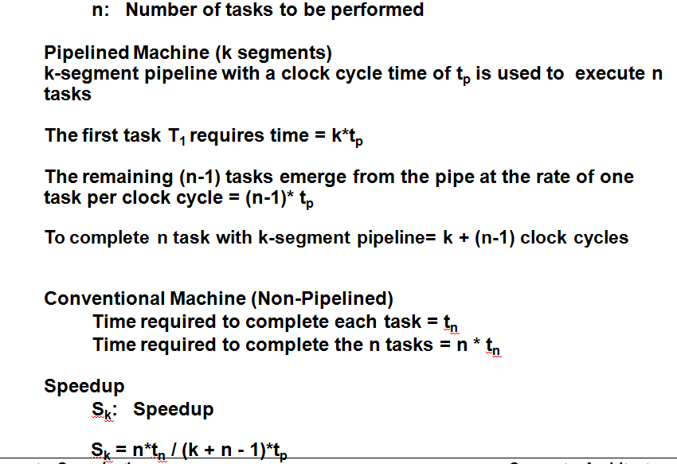
Pipeline Speedup

Slide 6
Q1. In certain scientific computation it is necessary to perform the arithmetic operation (Ai+Bi)*(Ci+Di)
Specify the pipeline configuration to carry out this task.
List the content of all registers of all the registers in the pipeline for i=1 to 6.
Q2. Draw a space time diagram for a six-segment pipeline showing the time it takes to process eight tasks.
Q3. A non-pipelined system takes 50ns to process a task. The same task can be processed in a six-segment pipeline with a clock cycle of 10ns. Determine the speedup ratio of the pipeline for 100 tasks.

Slide 7
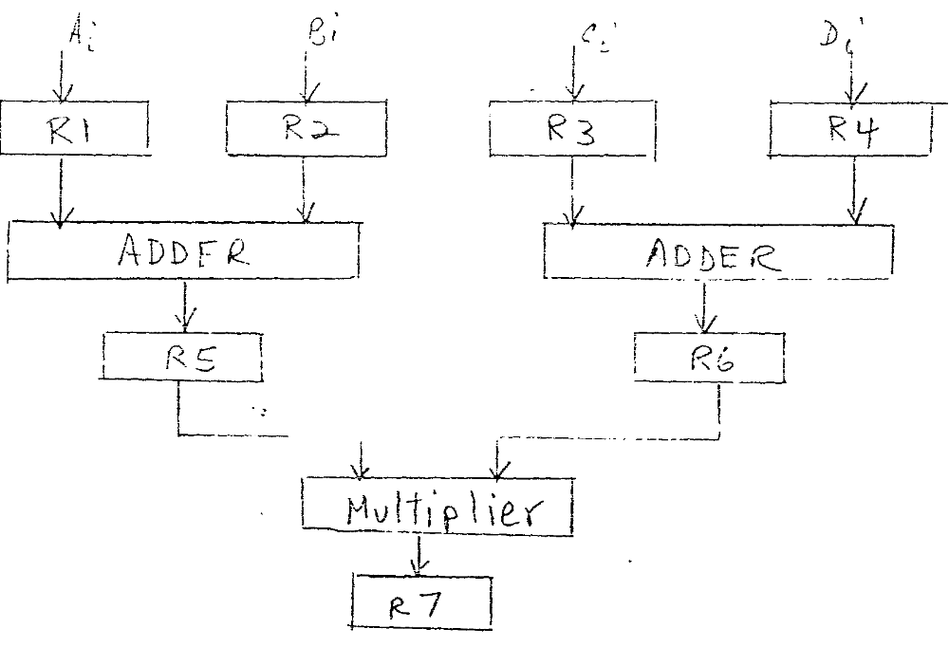

Slide 8
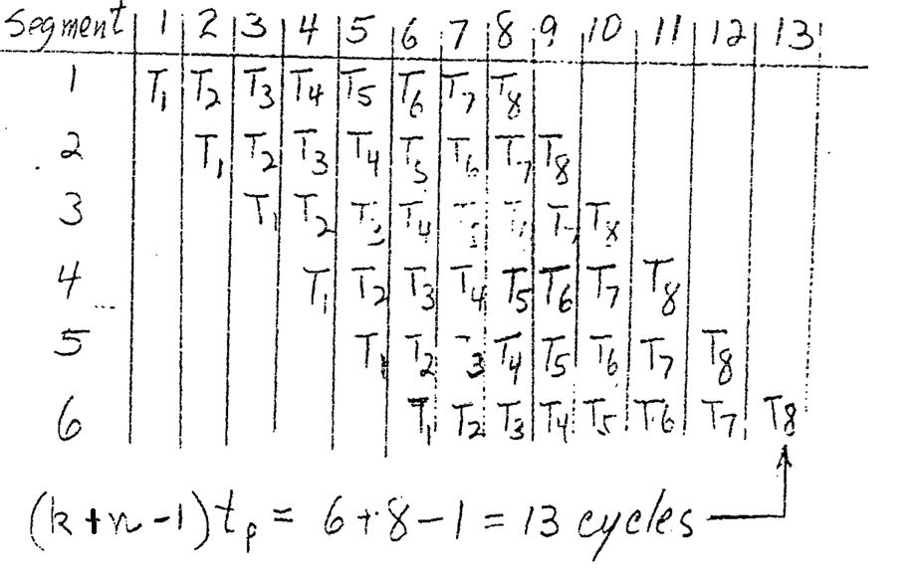

Slide 9
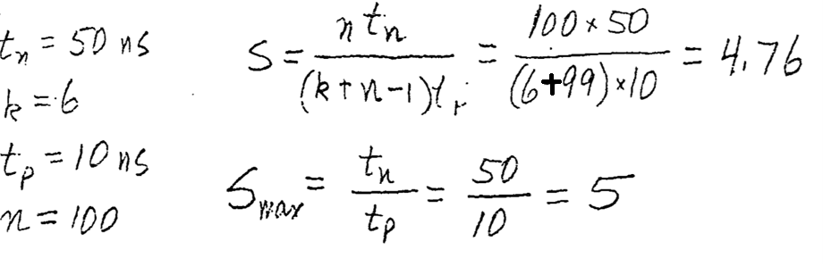

Slide 10
Problem
Consider a pipeline having 4 phases with duration 60, 50, 90 and 80 ns. Given latch delay is 10 ns. Calculate-
  1. Pipeline cycle time
  2. Non-pipeline execution time
  3. Speed up ratio
  4. Pipeline time for 1000 tasks
  5. Sequential time for 1000 tasks
  6. Throughput

Slide 11
Solution-
Given-
• Four stage pipeline is used
• Delay of stages = 60, 50, 90 and 80 ns
• Latch delay or delay due to each register = 10 ns
Part-01:
Pipeline Cycle Time-
Cycle time
= Maximum delay due to any stage + Delay due to its register
= Max { 60, 50, 90, 80 } + 10 ns
= 90 ns + 10 ns
= 100 ns

Slide 12
Part-02: Non-Pipeline Execution Time-
Non-pipeline execution time for one instruction
= 60 ns + 50 ns + 90 ns + 80 ns
= 280 ns
Part-03: Speed Up Ratio-
Speed up
= Non-pipeline execution time / Pipeline execution time
= 280 ns / Cycle time
= 280 ns / 100 ns
= 2.8

Slide 13
Part-04: Pipeline Time For 1000 Tasks-
Pipeline time for 1000 tasks
= Time taken for 1st task + Time taken for remaining 999 tasks
= 1 x 4 clock cycles + 999 x 1 clock cycle
= 4 x cycle time + 999 x cycle time
= 4 x 100 ns + 999 x 100 ns
= 400 ns + 99900 ns
= 100300 ns

Slide 14
Part-05: Sequential Time For 1000 Tasks-
Non-pipeline time for 1000 tasks
= 1000 x Time taken for one task
= 1000 x 280 ns
= 280000 ns
Part-06: Throughput-
Throughput for pipelined execution
= Number of instructions executed per unit time
= 1000 tasks / 100300 ns

Slide 15
BASIC COMPUTER ORGANIZATION AND DESIGN
✓ Computer Registers
✓ Computer Instructions
✓ Timing And Control
✓ Instruction Cycle
✓ Register – Reference Instructions
✓ Memory – Reference Instructions
✓ Input – Output And Interrupt

Slide 16
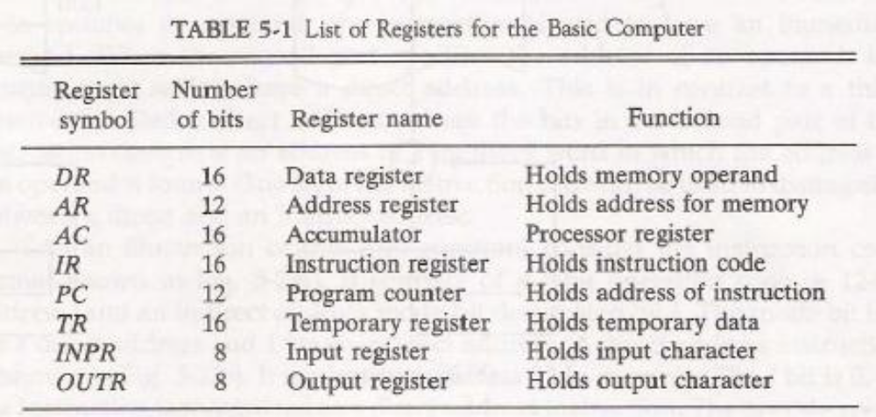
Computer Registers:

Slide 17
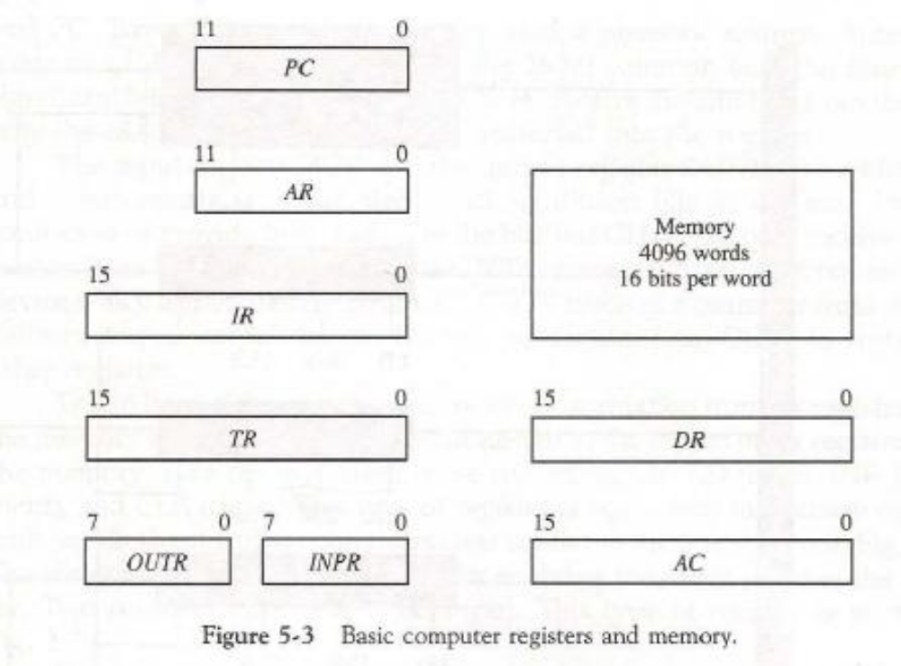

Slide 18
The data register (DR) holds the operand read from memory.
The accumulator (AC) register is a general purpose processing register.
The instruction read from memory is placed in the instruction register (IR).
The temporary register (TR) is used for holding temporary data during the processing.
The memory address register (AR) has 12 bits since this is the width of a memory address.
The program counter (PC) also has 12 bits and it holds the address of the next instruction to be read from memory after the current instruction is executed.
Two registers are used for input and output.
The input register (INPR) receives an 8-bit character from an input device.
The output register (OUTR) holds an 8-bit character for an output device.

Slide 19
Common Bus System:
The basic computer has eight registers, a memory unit, and a control unit .
Paths must be provided to transfer information from one register to another and between memory and registers.
A more efficient scheme for transferring information in a system with many registers is to use a common bus.
The connection of the registers and memory of the basic computer to a common bus system is shown in Fig. 5-4.
The outputs of seven registers and memory are connected to the common bus.

Slide 20
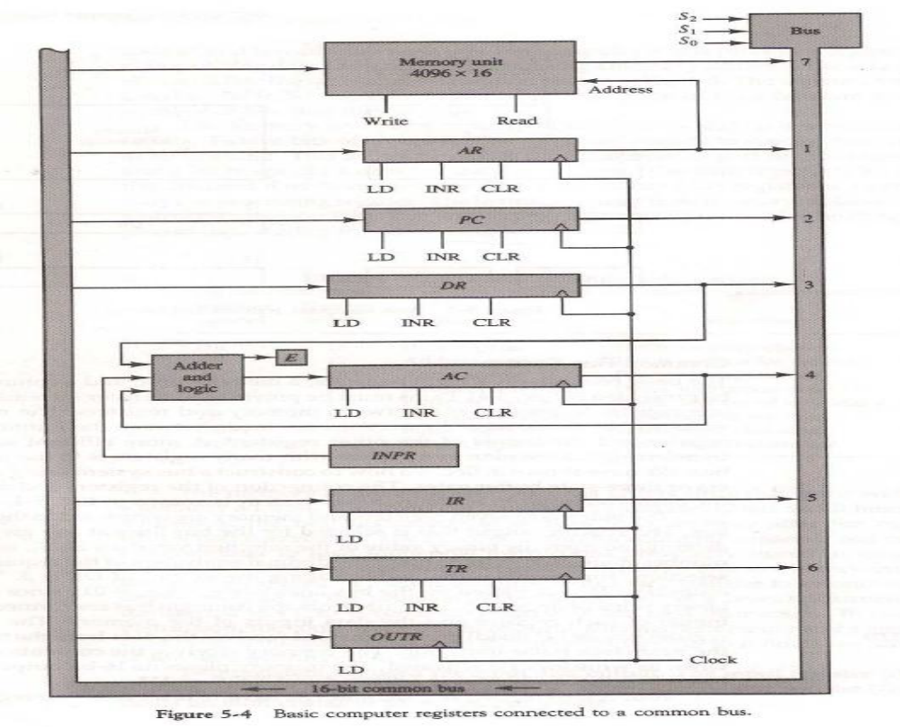

Slide 21
The number along each output shows the decimal equivalent of the required binary selection.
For example, the number along the output of DR is 3. The 16-bit outputs of DR are placed on the bus lines when S₂S₁S₀ = 011.
Five registers have three control inputs: LD (load), INR (increment), and CLR (clear).
The result of an addition is transferred to AC and the end carry-out of the addition is transferred to flip-flop E (extended AC bit).
A third set of 8-bit inputs come from the input register INPR.
The content of any register can be applied onto the bus and an operation can be performed in the adder and logic circuit during the same clock cycle.

Slide 22
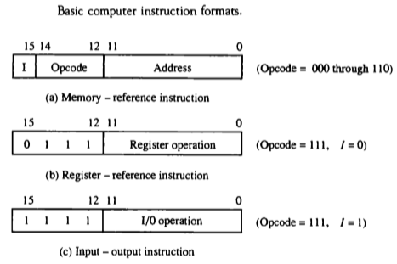
Computer Instructions
The basic computer has three instruction code formats.
Each format has 16 bits.
The operation code(op-code) part of the instruction contains three bits and the meaning of remaining 13 bits depends upon the op-code encountered.

Slide 23
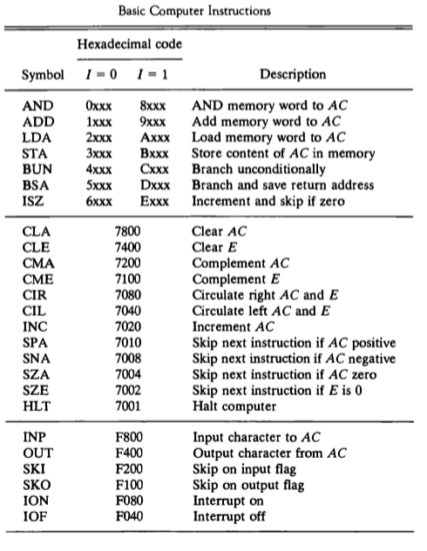
Computer Instruction Set

Slide 24
TIMING and CONTROL UNIT

Slide 25
The Control Unit was historically defined as one distinct part of the 1946 reference model of Von Neumann architecture.
The function of control unit is to generate relevant timing and control signals to all operations in the computer.
It controls the flow of data between the processor and memory and peripherals.
The examples of devices that require a control unit are CPUs and graphics processing units (GPUs).

Slide 26
FUNCTIONS
The control unit must communicate with both the arithmetic logic unit (ALU) and main memory.
The control unit instructs the arithmetic logic unit that which logical or arithmetic operation is to be performed.
The control unit co-ordinates the activities of the other two units as well as all peripherals and auxiliary storage devices linked to the computer.

Slide 27
TYPES
Control unit generates control signals using one of the two organizations :
Hardwired Control Unit.
Micro-programmed Control Unit.

Slide 28
Hardwired Control Unit
Hardwired control units are implemented through use of sequential logic units or circuits like gates , fliflops , decoders in hardware.
Hardwired control units are generally faster than micro-programmed designs.
This architecture is preferred in reduced instruction set computers (RISC) as they use a simpler instruction set.
The hardwired approach has become less popular as computers have evolved as at one time, control units for CPUs were ad-hoc logic, and they were difficult to design.

Slide 29
ADVANTAGES
Hardwired Control Unit is fast because control signals are generated by combinational circuits.
The delay in generation of control signals depends upon the number of gates.
The performances is high as compared to micro-programmed control unit.

Slide 30
DISADVANTAGES
The control signals required by the CPU will be more complex
Modifications in control signal are very difficult. That means it requires rearranging of wires in the hardware circuit.
It is difficult to correct mistake in original design or adding new features in existing design of control unit.

Slide 31
CONSIST OF:
Control unit consist of a:
Instruction Register
Number of Control Logic Gates,
Two Decoders
4-bit Sequence Counter

Slide 32
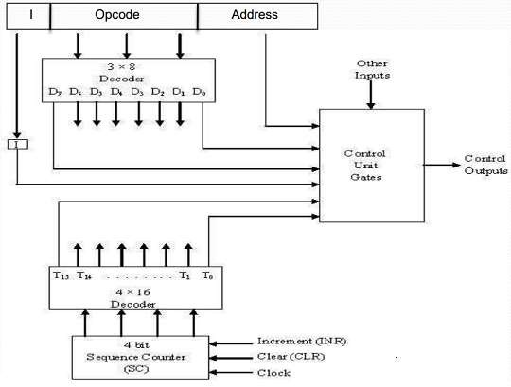
ARCHITECTURE

Slide 33
An instruction read from memory is placed in the instruction register (IR).
The instruction register is divided into three parts: the I bit, operation code, and address part.
First 12-bits (0-11) to specify an address, next 3-bits specify the operation code (opcode) field of the instruction and last left most bit specify the addressing mode I.
I = 0 for direct address
I = 1 for indirect address

Slide 34
First 12-bits (0-11) are applied to the control logic gates.
The operation code bits (12 – 14) are decoded with a 3 x 8 decoder.
The eight outputs ( D₀ through D₇) from a decoder goes to the control logic gates to perform specific operation.
Last bit 15 is transferred to a I flip-flop designated by symbol I.

Slide 35
The 4-bit sequence counter SC can count in binary from 0 through 15.
The counter output is decoded into 16 timing pulses T₀ through T₁₅.
The sequence counter can be incremented by INR.
input or clear by CLR input synchronously.

Slide 36
EXAMPLE
Consider the case where SC is incremented to provide timing signalsT0, T1, T 2 , T3, and T4 in sequence. At time T4 , SC is cleared to 0 if decoder output D3 is active. This is expressed symbolically by the statement:
D3 T4 : SC ← 0
The timing diagram shows the time relationship of the control signals.

Slide 37
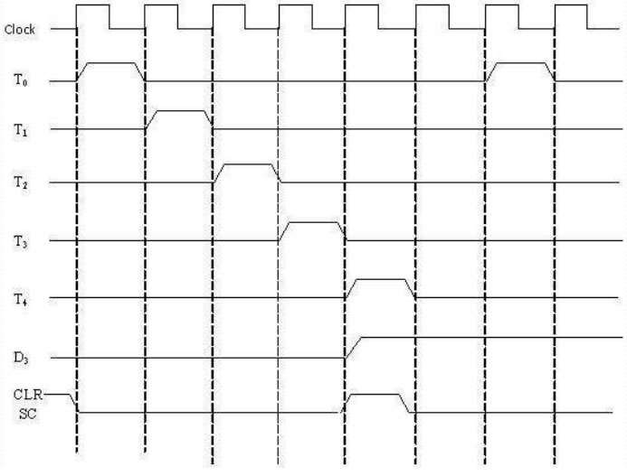
TIMING DIAGRAM

Slide 38
MICRO-PROGRAMMED CONTROL UNIT
The idea of microprogramming was introduced by Maurice Wilkes in 1951.
Micro-programs were organized as a sequence of microinstructions and stored in special control memory.
The main advantage of the micro-program control unit is the simplicity of its structure.
Outputs of the controller are organized in microinstructions and they can be easily replaced

Slide 39
A micro-programmed control unit is implemented using programming approach. A sequence of micro operations are carried out by executing a program consisting of micro-instructions.
Micro-program, consisting of micro-instructions is stored in the control memory of the control unit.
Execution of a micro-instruction is responsible for generation of a set of control signals.

Slide 40
Micro-Programs: Microprogramming is the concept for generating control signals using programs. These programs are called micro - programs.
Micro-Instructions: The instructions that make micro-program are called micro-instructions.
Micro-Code: Micro-program is a group of microinstructions. The micro- program can also be termed as micro-code.
Control Memory: Micro-programs are stored in the read only memory (ROM). That memory is called control memory.

Slide 41
ADVANTAGES
The design of micro-program control unit is less complex because micro-
programs are implemented using software routines.
The micro-programmed control unit is more flexible because design modifications, correction and enhancement is easily possible.
The new or modified instruction set of CPU can be easily implemented by
simply rewriting or modifying the contents of control memory.
The fault can be easily diagnosed in the micro-program control unit using diagnostics tools by maintaining the contents of flags, registers and counters.

Slide 42
DISADVANTAGES
The micro-program control unit is slower than hardwired control unit.
That means to execute an instruction in micro-program control unit requires more time.
The micro-program control unit is expensive than hardwired control unit
in case of limited hardware resources.
The design duration of micro-program control unit is more than hardwired control unit for smaller CPU.

Slide 43
CONSIST OF :
Control unit consist of a :
Next address generator
Control address register
Control memory
Control data register

Slide 44
ARCHITECTURE
The address of micro-instruction that is to be executed is stored in the
control address register (CAR).
Micro-instruction corresponding to the address stored in CAR is fetched from control memory and is stored in the control data register (CDR).
This micro-instruction contains control word to execute one or more
micro-operations.
After the execution of all micro-operations of micro-instruction, the address of next micro-instruction is located.

Slide 45
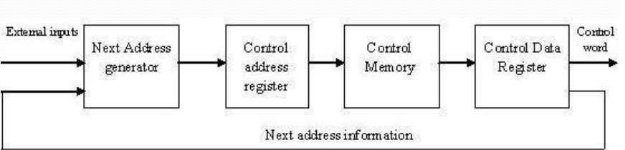

Slide 46
COMPARISON BETWEEN HARDWIRED AND MICROPRGRAMMED
CONTROL UNIT
ATTRIBUTE | HARDWIRED CONTROL UNIT | MICRO-PROGRAMMED CONTROL UNIT
SPEED | FAST | SLOW
COST OF IMPLEMENTATION | MORE | CHEAPER
FLEXIBILITY | NOT FLEXIBLE, DIFFICULT TO MODIFY FOR NEW INSTRUCTION | FLEXIBLE, NEW INSTRUCTIONS CAN BE ADDED
ABILITY TO HANDLE COMPLEX INSTRUCTION | DIFFICULT | EASIER
DECODING | COMPLEX | EASY
APPLICATION | RISC MICROPROCESSOR | CISC MICROPROCESSOR
INSTRUCTION SET SIZE | SMALL | LARGE
CONTROL MEMORY | ABSENT | PRESENT
CHIP AREA REQUIRED | LESS | MORE

Slide 47
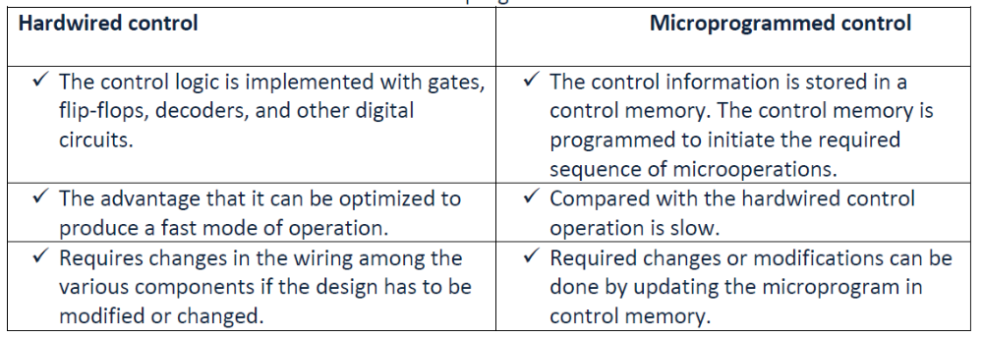

Slide 48
Instruction Cycle
The program is executed in the computer by going thru a cycle for each instruction.
In basic computer, each instruction cycle consists of the following phases:
Fetch an instruction from memory.
Decode the instruction.
Read the effective address from memory.
Execute the instruction.

Slide 49
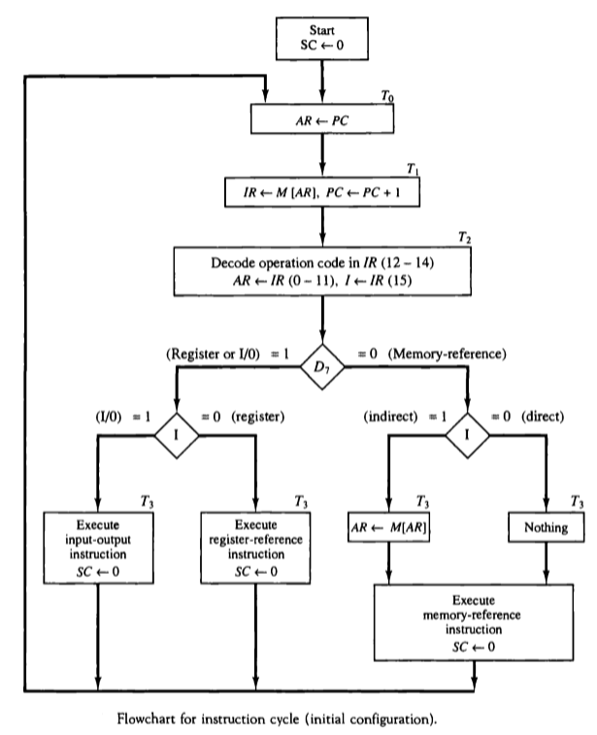
Instruction Cycle

Slide 50

Instruction Cycle
Micro-operations for fetch & decode

Slide 51
Register-Reference Instructions
Register-reference instructions are recognized by the control when D7 = 1 and I=0.
➢ These instructions use bits 0 through 11 of the instruction code to specify one of 12 instructions.
➢ These 12 bits are available in IR (0-11).

Slide 52
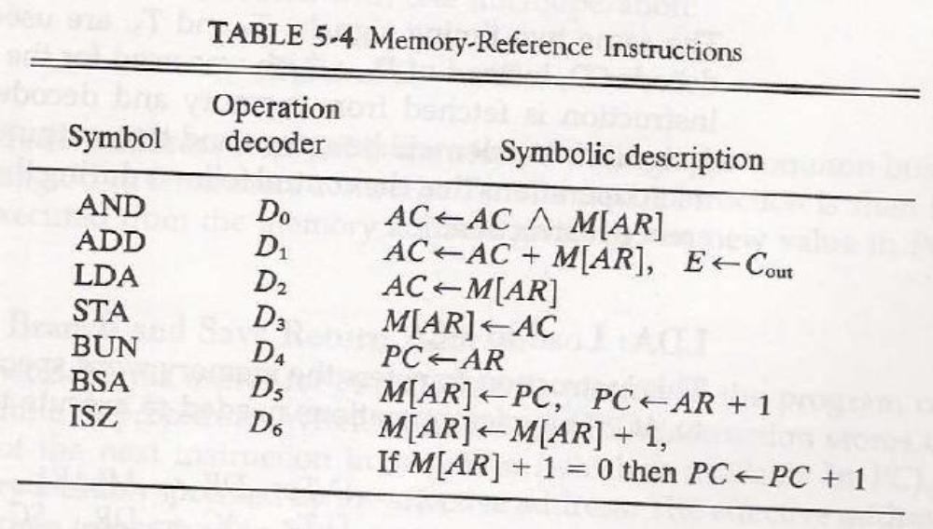
Memory-Reference Instructions:

Slide 53
The decoded output Di for i = 0, 1, 2, 3, 4, 5, and 6 from the operation decoder that belongs to each instruction is included in the table.
➢ The effective address of the instruction is in the address register AR and was placed there during timing signal T2 when I= 0, or during timing signal T3 when I = 1.
➢ The execution of the memory-reference instructions starts with timing signal T4.

Slide 54
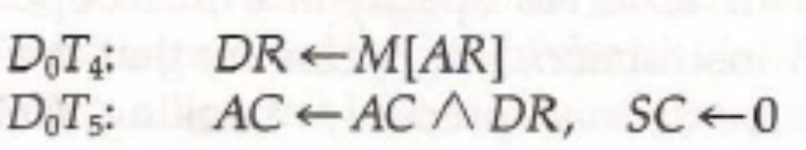
AND to AC:
➢ This is an instruction that performs the AND logic operation on pairs of bits in AC and the memory word specified by the effective address.
➢ The result of the operation is transferred to AC.
➢ The microoperations that execute this instruction are:

Slide 55
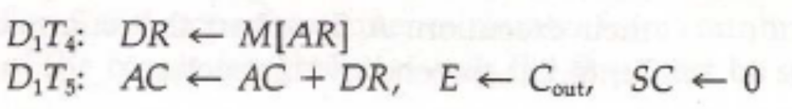
ADD to AC:
➢ This instruction adds the content of the memory word specified by the effective address to the value of AC.
➢ The sum is transferred into AC and the output carry Cout is transferred to the E (extended accumulator) flip-flop.
➢ The microoperations needed to execute this instruction are LDA:

Slide 56
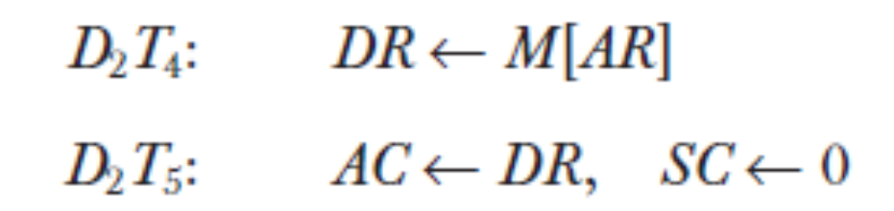
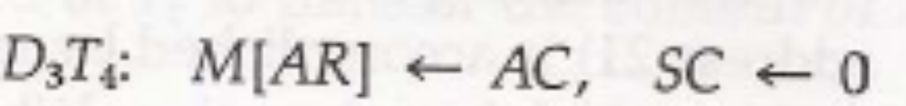
LDA: Load to AC
➢ This instruction transfers the memory word specified by the effective address to AC.
➢ The microoperations needed to execute this instruction are
STA: Store AC
➢ This instruction stores the content of AC into the memory word specified by the effective address.
➢ Since the output of AC is applied to the bus and the data input of memory is connected to the bus, we can execute this instruction with one microoperation.

Slide 57
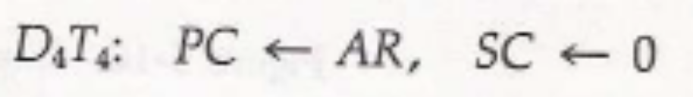
BUN: Branch Unconditionally
➢ This instruction transfers the program to the instruction specified by the effective address.
➢ The BUN instruction allows the programmer to specify an instruction out of sequence and we say that the program branches (or jumps) unconditionally.
➢ The instruction is executed with one microoperation:

Slide 58
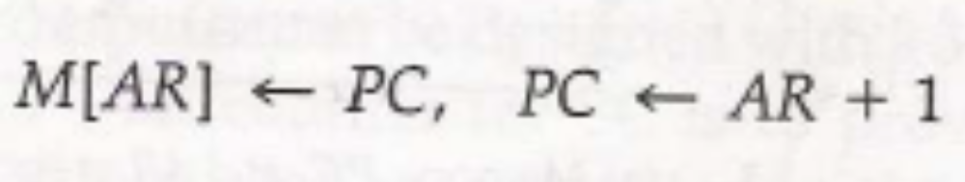
BSA: Branch and Save Return Address
This instruction is useful for branching to a portion of the program called a subroutine or procedure.
When executed, the BSA instruction stores the address of the next instruction in sequence (which is available in PC) into a memory location specified by the effective address.
The effective address plus one is then transferred to PC to serve as the address of the first instruction in the subroutine.
This operation was specified with the following register transfer:

Slide 59
Register-Reference Instructions:
Register-reference instructions are recognized by the control when D7 = 1 and I=0.
These instructions use bits 0 through 11 of the instruction code to specify one of 12 instructions.
These 12 bits are available in IR (0-11).
The control functions and microoperations for the register-reference instructions are listed in Table 5-3.
These instructions are executed with the clock transition associated with timing variable T3.
Control function needs the Boolean relation D7I’T3, which we designate for convenience by the symbol r.
By assigning the symbol Bi to bit i of IR, all control functions can be simply denoted by rBi.

Slide 60
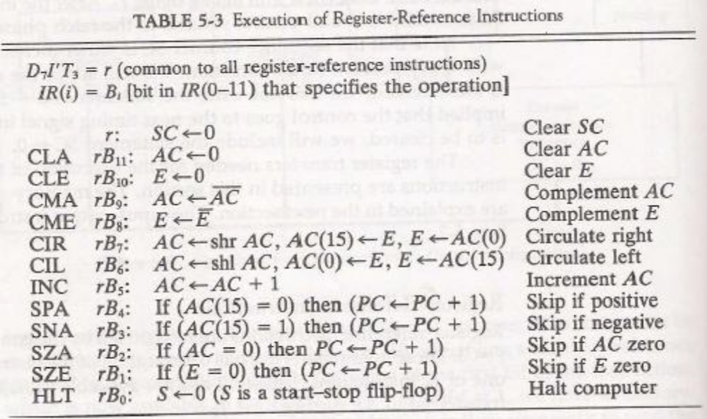

Slide 61
Input-Output Configuration:
The terminal sends and receives serial information.
Each quantity of information has eight bits of an alphanumeric code.
The serial information from the keyboard is shifted into the input register INPR.
The serial information for the printer is stored in the output register OUTR.
These two registers communicate with a communication interface serially and with the AC in parallel.
The input—output configuration is shown in Fig. 5-12.

Slide 62
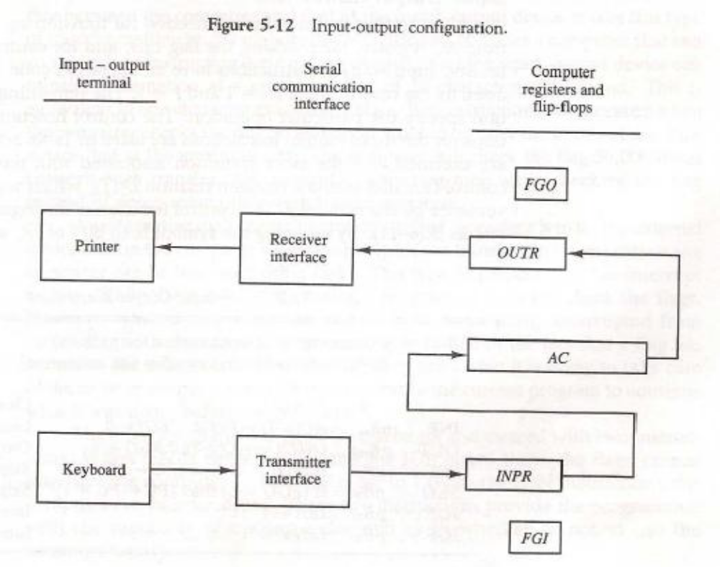

Slide 63
The input register INPR consists of eight bits and holds alphanumeric input information.
The 1-bit input flag FGI is a control flip-flop.
The flag bit is set to 1 when new information is available in the input device and is cleared to 0 when the information is accepted by the computer.
The output register OUTR works similarly but the direction of information flow is reversed.
Initially, the output flag FGO is set to 1.
The computer checks the flag bit; if it is 1, the information from AC is transferred in parallel to OUTR and FGO is cleared to 0.
The output device accepts the coded information, prints the corresponding character, and when the operation is completed, it sets FGO to 1.

Slide 64
Fundamental Concepts
Processor fetches one instruction at a time and perform the operation specified.
Instructions are fetched from successive memory locations until a branch or a jump instruction is encountered.
Processor keeps track of the address of the memory location containing the next instruction to be fetched using Program Counter (PC).
Instruction Register (IR)

Slide 65
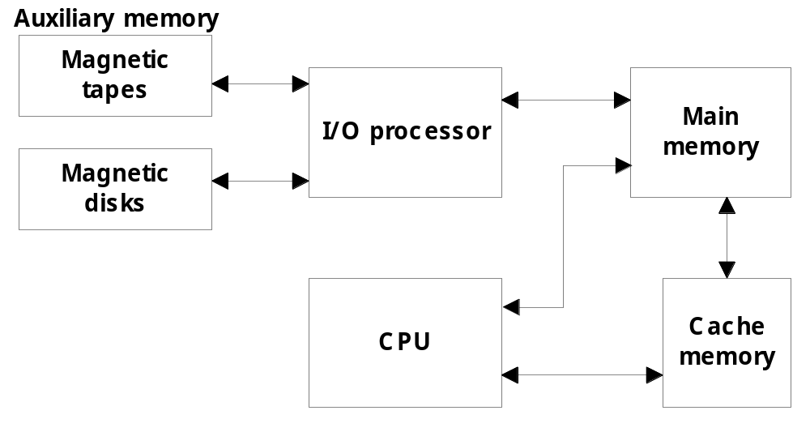
Memory Organization
Memory Hierarchy
  Memory hierarchy in a computer system :
    Main Memory : memory unit that communicates directly with the CPU (RAM)
    Auxiliary Memory : device that provide backup storage (Disk Drives)
    Cache Memory : special very-high-speed memory to increase the processing speed (Cache RAM)

Slide 66
Memory Organization
  Multiprogramming
    enable the CPU to process a number of independent program concurrently
  Memory Management System :
    supervise the flow of information between auxiliary memory and main memory
Register
Cache
Main Memory
Magnetic Disk
Magnetic Tape
Memory Hierarchy is to obtain the highest possible access speed while minimizing the total cost of the memory system

Slide 67
Random Access Memory (RAM)
  RAM Chips
  Static RAM
  Consists of Flip-flops to store binary information.
  Static RAM is easier to use and having short Read/Write cycles
  Used mostly in Cache memory.
  Dynamic RAM
  Stores binary information in the form of electric charge stored inside the capacitor.
  The capacitors are provided by MOS transistors.
  Refreshing circuit is required to refresh the memory.
  Dynamic RAM offers reduced power consumption and large storage capacity.
  It is used to construct main memory.
    Typical RAM chip :
      128 X 8 RAM : 2⁷ = 128 (7 bit address lines)
    Typical ROM chip:
      512 X 8 ROM : 2⁹ = 512 (9 bit address lines

Slide 68

Three State Buffer
Normal input A
Output Y=A if C=1
High-impedence if C=0
Control input C
Select
S₁
0
S₀
1
2×4 Decoder
A₀
2
Enable
E
3
B₀
C₀
Bus line with three-state buffer (replaces MUX0 in the previous diagram)
D₀

Slide 69
MAIN MEMORY
Main Memory
RAM and ROM Chips
Typical RAM chip
Chip select 1
CS1
Chip select 2
CS2
128 x 8
Read
RD
RAM
8-bit data bus
Write
WR
7-bit address
AD 7
CS1 CS2 RD WR
Memory function
State of data bus
0 0 x x
Inhibit
High-impedence
0 1 x x
Inhibit
High-impedence
1 0 0 0
Inhibit
High-impedence
1 0 0 1
Write
Input data to RAM
1 0 1 x
Read
Output data from RAM
1 1 x x
Inhibit
High-impedence
Typical ROM chip
Chip select 1
CS1
Chip select 2
CS2
512 x 8
8-bit data bus
ROM
9-bit address
AD 9

Slide 70
MEMORY ADDRESS MAP
Main Memory
Address space assignment to each memory chip
Example: 512 bytes RAM and 512 bytes ROM
Hexadecimal
address
Address bus
Component
10 9 8 7 6 5 4 3 2 1
RAM 1
RAM 2
RAM 3
RAM 4
ROM
0000 - 007F
0080 - 00FF
0100 - 017F
0180 - 01FF
0200 - 03FF
0 0 0 x x x x x x x
0 0 1 x x x x x x x
0 1 0 x x x x x x x
0 1 1 x x x x x x x
1 x x x x x x x x x
Memory Connection to CPU
- RAM and ROM chips are connected to a CPU
through the data and address buses
- The low-order lines in the address bus select
the byte within the chips and other lines in the
address bus select a particular chip through
its chip select inputs

Slide 71

CONNECTION OF MEMORY TO CPU
Main Memory
Address bus
CPU
16-11
10
9
8
7-1
RD
WR
Data bus
Decoder
3
2
1
0
CS1
CS2
128 x 8
Data
RD
RAM 1
WR
AD7
CS1
CS2
128 x 8
Data
RD
RAM 2
WR
AD7
CS1
CS2
128 x 8
Data
RD
RAM 3
WR
AD7
CS1
CS2
128 x 8
RD
RAM 4
Data
WR
AD7
CS1
1- 7
CS2
512 x 8
8
ROM
Data
9
AD9

Slide 72
Numerical Problems
Q1. a) How many 128x8 RAM chips are needed to provide a memory capacity of 2048 bytes.
b) How any lines of the address bus must be used to access 2048 bytes of memory. How many of these lines will be common to all chips.
c) How many lines must be decoded for chip select? Specify the size of decoders.
Q2. Extend the memory system of Fig.1 to 4096 bytes of RAM and 4096 bytes of RAM. List the memory-address map and indicate what size decoders are needed.
Q3. A computer employs RAM chips of 256x8 and ROM chips of 1024x8. The computer system needs 2K bytes of RAM, 4K bytes of ROM, and four interface units each with four registers. A memory-mapped I/O configuration used. The two highest-order bits of the address bus are assigned 00 for RAM, 01 for ROM, and 10 for interface registers.
How many RAM and ROM chips are needed.
Draw a memory-address map for the system.
Give the address range in hexadecimal for RAM, ROM and interface.

Slide 73
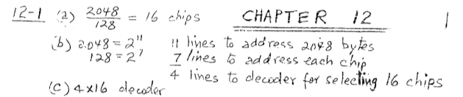
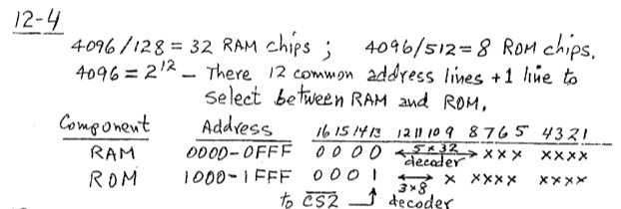

Slide 74
Cache Memory
12-5 Cache Memory
  Locality of Reference
    the references to memory tend to be confined within a few localized areas in memory
  Cache Memory : a fast small memory
    keeping the most frequently accessed instructions and data in the fast cache memory
  Hit Ratio
    the ratio of the number of hits divided by the total CPU references (hits + misses) to memory
      hit : the CPU finds the word in the cache
      miss : the word is not found in cache (CPU must read main memory)
  A computer with cache access time of 100ns, a main memory access time of 1000 ns, a hit ratio of 0.9 is having average access time of 200ns.

Slide 75
Types of Mapping of Cache Memory
  Mapping
    The transformation of data from main memory to cache memory
      1) Associative mapping
      2) Direct mapping
      3) Set-associative mapping
  Associative Mapping:
    main memory : 32 K x 12 bit word (15 bit address lines)
    cache memory : 512 x 12 bit word
      CPU sends a 15-bit address to cache
        Hit : CPU accepts the 12-bit data from cache
        Miss : CPU reads the data from main memory (then data is written to cache)

Slide 76
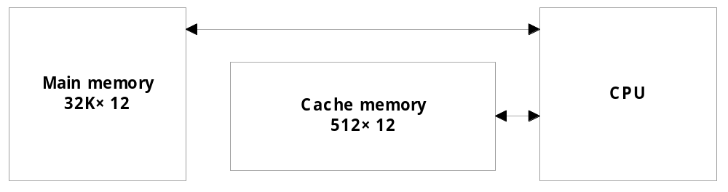
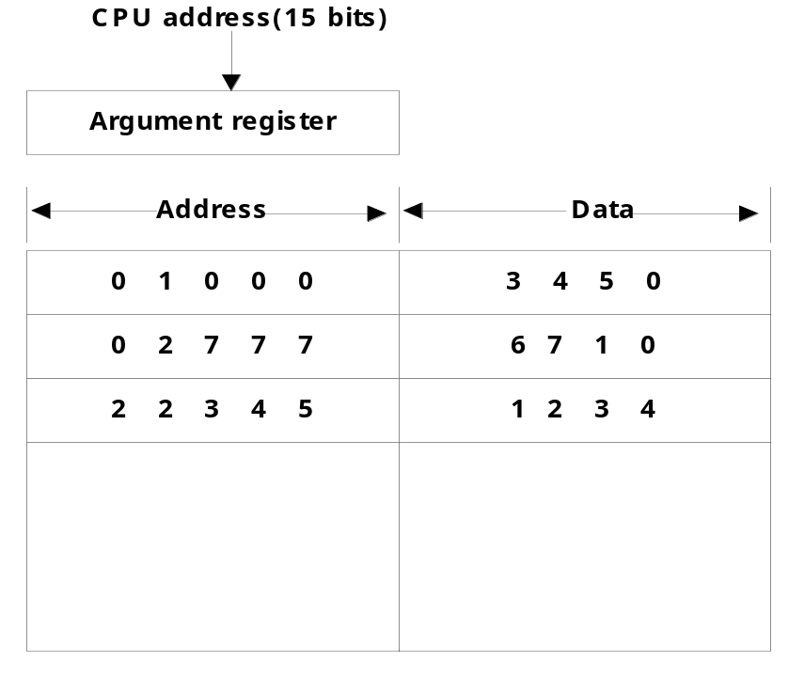
Associative Mapping

Slide 77
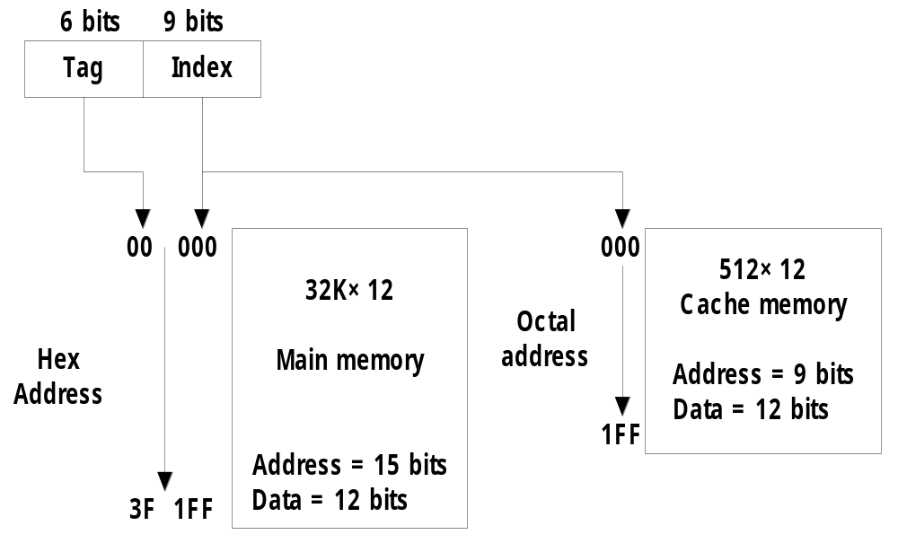
Direct Mapping
  Direct mapping :
    n bit memory address
    Tag field (n - k) : Index field (k)
    2^{k} words cache memory + 2^{n} words main memory
        Tag = 6 bit (15 - 9), Index = 9 bit

Slide 78
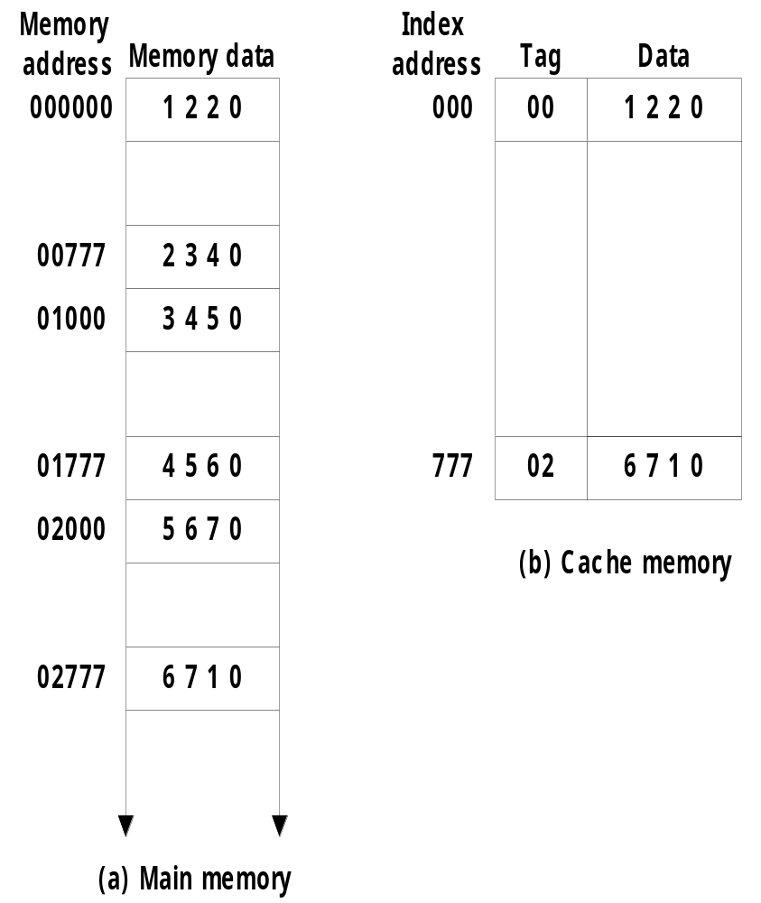
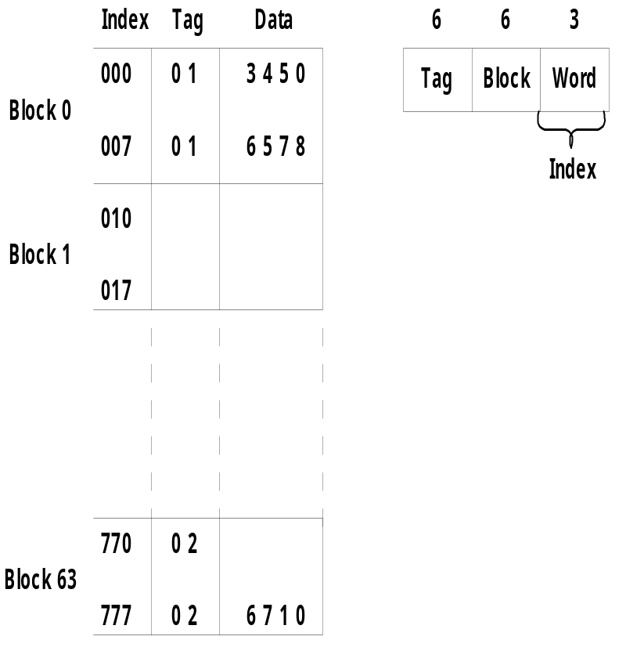
Direct Mapping
    Direct mapping cache with block size of 8 words :
      64 block x 8 word = 512 cache words size

Slide 79
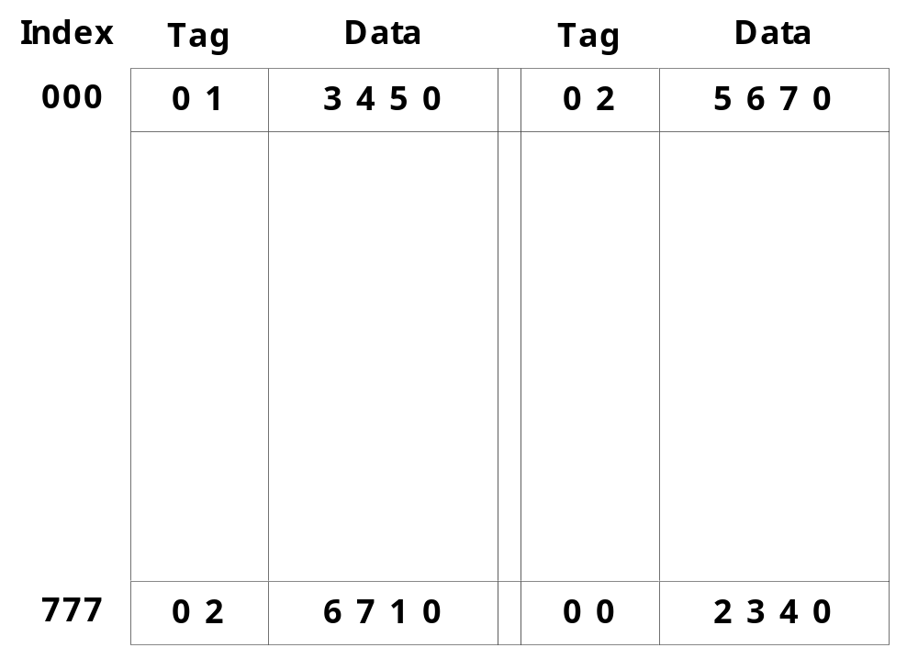
Set-Associative Mapping
  Set-associative mapping : (two-way)

Slide 80
Questions
A two-way set associative cache memory uses blocks of four words. The cache can accommodate a total of 2048 words from main memory. The main memory size is 128Kx32. Formulate all pertinent information required to construct the cache memory. What is the size of cache memory.
A computer has a memory unit of 64Kx16 and a cache memory of 1K words. The cache uses direct mapping with a block size of four words. How many bits are there in the tag, index, block, and words fields of the address format. How many bits are there in each word of cache, and how are they divided into functions? Include a valid bit. How many blocks can the cache accommodate?
The access time of a cache memory is 100ns and that of main memory is 1000ns. It is estimated that 80 percent of the memory requests are for read and the remaining 20 percent for write. The hit ratio for read access only is 0.9. A write-through procedure is used. What is the average access time of the system considering only memory read cycles. What is the average access time of the system for both read and write requests. What is the hit ratio considering the write requests also.

Slide 81
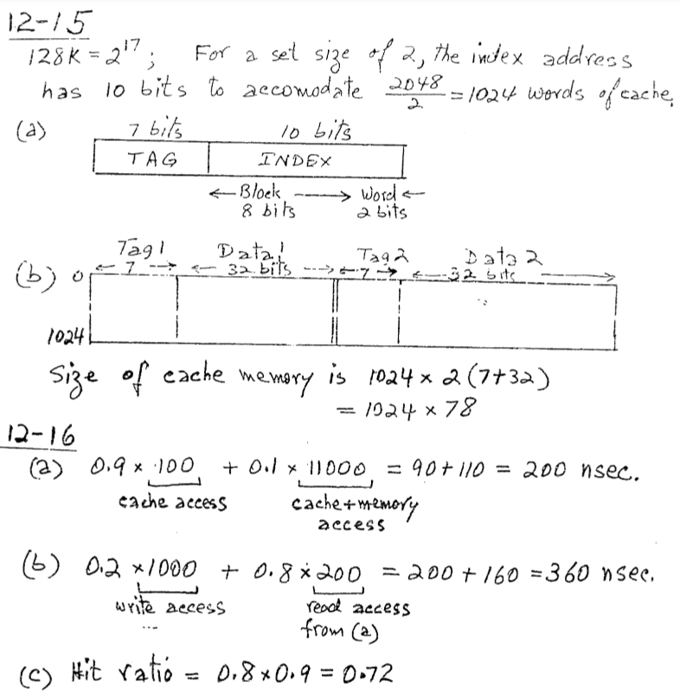
Answer

Slide 82
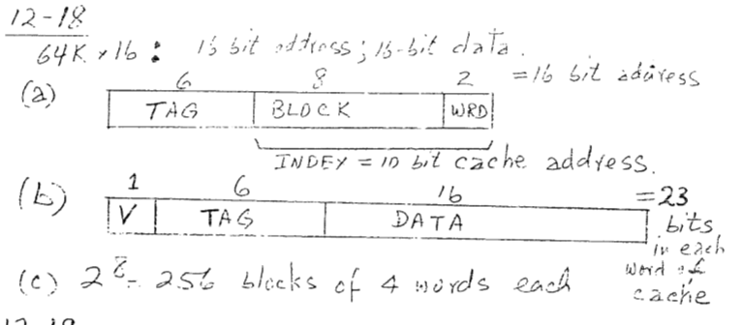
Answer

Slide 83
  Replacement Algorithm : cache miss or full
    1) LRU (Least Recently Used):
    2) Random Replacement:
    3) FIFO (First-In First-Out) :
  Writing to Cache :
      1) Write-through :
      2) Write-back :
In write-through, data is simultaneously updated to cache and memory. This process is simpler and more reliable. This is used when there are no frequent writes to the cache(The number of write operations is less).
It helps in data recovery (In case of a power outage or system failure). A data write will experience latency (delay) as we have to write to two locations (both Memory and Cache).
In write back-
The data is updated only in the cache and updated into the memory at a later time. Data is updated in the memory only when the cache line is ready to be replaced.

Slide 84
  Cache Initialization
    Cache is initialized :
      1) When power is applied to the computer
      2) When main memory is loaded with a complete set of programs from auxiliary memory
      3) Cache is initialized by clearing all the valid bits to 0.
    Valid bit
      Indicate whether or not the word contains valid data

Slide 85
Virtual Memory
VIRTUAL MEMORY
Give the programmer the illusion that the system has a very large memory,
even though the computer actually has a relatively small main memory
Address Space(Logical) and Memory Space(Physical)
address space
memory space
virtual address
(logical address)
Mapping
physical address
address generated by programs actual main memory address

Slide 86
Virtual Memory
VIRTUAL MEMORY
Give the programmer the illusion that the system has a very large memory,
even though the computer actually has a relatively small main memory
Address Space(Logical) and Memory Space(Physical)
address space
memory space
virtual address
(logical address)
Mapping
physical address
address generated by programs actual main memory address
Address Mapping
Memory Mapping Table for Virtual Address -> Physical Address
Virtual address
Virtual
Memory
Main memory
address
mapping
address
Main
register
table
register
memory
Physical
Address
Memory table
Main memory
buffer register
buffer register

Slide 87
ADDRESS MAPPING
Virtual Memory
Address Space and Memory Space are each divided
into fixed size group of words called blocks or pages
1K words group
Page 0
Page 1
Address space
N = 8K = 2¹³
Page 2
Block 0
Page 3
Memory space
M = 4K = 2¹²
Block 1
Page 4
Block 2
Page 5
Block 3
Page 6
Page 7
Organization of memory Mapping Table in a paged system
Page no.
Offset
1 0 1
0 1 0 1 0 1 0 0 1 1
Virtual address
Table
Presence
address
bit
000
0
Main memory
001
11
1
Block 0
010
00
1
Block 1
011
0
0 1
0 1 0 1 0 1 0 0 1 1
Block 2
100
0
Main memory
Block 3
101
01
1
address register
Memory page table
110
10
1
111
0
MBR
01
1

Slide 88
PAGE REPLACEMENT ALGORITHMS
Virtual Memory
FIFO
Reference string
7
0
1
2
0
3
0
4
2
3
0
3
2
1
2
0
1
7
0
1
7
7
7
2
2
2
4
4
4
0
0
0
7
7
7
0
0
0
3
3
3
2
2
2
1
1
1
0
0
1
1
1
0
0
0
3
3
3
2
2
2
1
Page frames
FIFO algorithm selects the page that has been in memory the longest time
Optimal Replacement (OPT) - Lowest page fault rate of all algorithms
Replace that page which will not be used for the longest period of time
Reference string
7
0
1
2
0
3
0
4
2
3
0
3
2
1
2
0
1
7
0
1
7
7
7
2
2
2
2
2
7
0
0
0
0
4
0
0
0
1
1
3
3
3
1
1
Page frames

Slide 89
PAGE REPLACEMENT ALGORITHMS
Virtual Memory
LRU
- OPT is difficult to implement since it requires future knowledge
Replace that page which has not been
used for the longest period of time
Reference string
7
0
1
2
0
3
0
4
2
3
0
3
2
1
2
0
1
7
0
1
7
7
7
2
2
4
4
4
0
1
1
1
0
0
0
0
0
0
3
3
3
0
0
1
1
3
3
2
2
2
2
2
7
Page frames

Slide 90
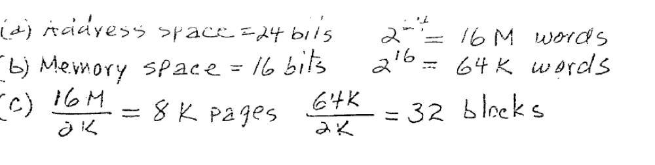
A virtual memory system has an address space of 8K words, a memory space of 4K words and page & block sizes are of 1K words. The following page is referenced in memory: 4 2 0 1 2 6 1 4 0 1 0 2 3 5 7. Determine the four pages that are resident in main memory after each page reference change if page replacement algorithm is : FIFO, LRU, Optimal.
An address space is specified by 24 bits and the corresponding memory space by 16 bits. How many words are there in the address space. How many words are there in the memory space. If a page consists of 2K words, how many pages and blocks are there in the system?

Slide 91
Question
The page request are in following order. If there are three memory frames, show the execution of the following pages using
a. FIFO b. Optimal c. LRU
6 0 1 3 2 5 0 4 7 1 3 2 6 0 4

Slide 92
Input-Output Organization
Peripheral Devices: Input & Output devices attached to computer are called Peripheral.
  Input Devices:
    Keyboard, Optical devices: Card reader, Bar code reader etc.
    Magnetic Input Devices: Magnetic stripe reader
    Screen Input Devices: Touch screen, Light pen etc.
  Output Devices:
    Keyboard, Optical devices: Card reader, Bar code reader etc.
    Peripherals that provide auxiliary storage are magnetic tape and magnetic disk.
    Input and output devices communicate alphanumeric information by using ASCII 7bit code.
    To use computer efficiently, large number of programs and data must be prepared in advance for execution with computer.
    Output Devices: CRT, Printer
    .

Slide 93
Input-Output Interface
I/O interface provides a method for transferring information between internal storage and external I/O devices.
The purpose of interfacing are as follows:
  Peripherals are electromechanical & electromagnetic devices and are interacting with electronics devices(CPU).
  Data transfer rate of peripherals is usually slower than transfer rate of CPU.
  Data codes and formats in peripherals differ from word format in CPU
  Operating modes of peripherals are different from each other and each one must be controlled without disturbing other.
To resolve these differences, computer system includes Interface units between CPU and peripherals to supervise and synchronize all input and output transfers.

Slide 94
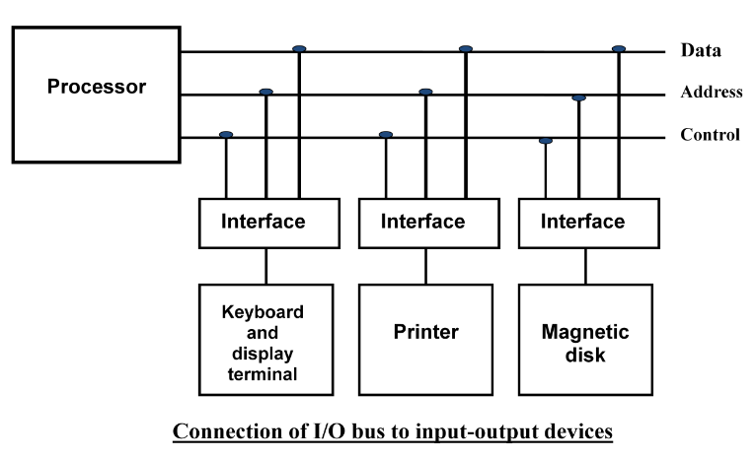
Input-Output Interface
Each peripheral has its own controller that operates a particular electromechanical device.
To communicate with a particular device, the processor places a device address on the address lines.

Slide 95
Input-Output Interface
When the interface detects it own address, it activates path between bus lines and the device.
At the time address is made available in address lines, the processor provides function code(I/O command) in the control lines.
Types of I/O command:
Control command: To activate and inform what to do.
Status command: To test various status conditions.
Data Output data: It causes the transfer of data from bus into one of its registers.
Data Input Command: Interface receives data from peripheral and places them on buffer register where it is put into data lines.

Slide 96
I/O versus Memory Bus
In addition to communicating to I/O, processor must also communicate with memory unit.
There are three ways that computer buses can be used to communicate with memory and I/O:
  Use two separate buses, one for memory and one for I/O. (IOP)
  Use one common bus for both memory and I/O but have separate control lines for each. (Isolated I/O)
  Use one common bus for memory and I/O with common control lines. (Memory Mapped I/O)

Slide 97
Isolated I/O
The distinction between memory and I/O transfer is made through separate read and control lines.
I/O read and I/O write are enabled during I/O transfer and Memory read/write are enabled during memory transfer.
In the isolated I/O configuration, CPU have distinct input and output instructions where each of it will be associated with address of the interface register.
When the CPU fetches and decodes the I/O instruction, it places the address associated with the instruction on the common address lines and enables I/O read or I/O write control line.
When the CPU fetches and decodes the Memory instruction, it places the address associated with the instruction on the common address lines and enables Memory read or Memory write control line.
The isolated I/O method isolates memory and I/O addresses.

Slide 98
Memory Mapped I/O
Here the same address space is used for both memory and I/O. The computer treats interface register as a part of memory system.
The assigned address cannot be used for storing memory words, which reduces memory address range available.
In a memory-mapped I/O organization, there are no specific, input or output instruction.
CPU manipulate I/O data residing in interface registers with the same instruction used to manipulate memory words.
Load and store instruction used for reading/writing from memory and can be use for input or output data from I/O instruction.
With memory-mapped I/O all instructions that refer to memory are also available for I/O.

Slide 99
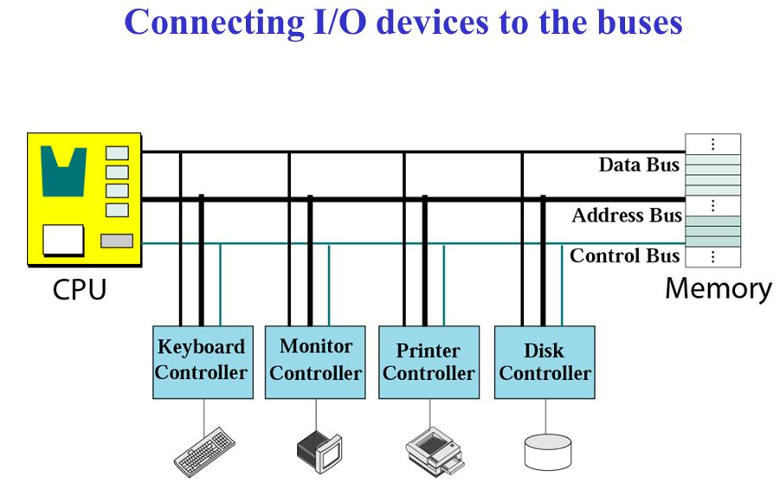
Memory Mapped I/O

Slide 100
Modes of Transfer
Data transfer between the CPU and the I/O devices may be handled in variety of modes. Some modes use the CPU as an intermediate path and others transfer the data directly to and from the memory unit.
Data transfer to and from peripherals may be handled in three ways:
  Programmed I/O
  Interrupt-initiated I/O
  Direct Memory Access (DMA)

Slide 101
Programmed I/O
Programmed I/O operations are the result of I/O instructions. Each data item transfer is initiate by an instruction in the program.
Usually the transfer is to and from a CPU register and peripheral. Other instructions are needed to transfer data between memory and CPU.
Once a data transfer is initiated, the CPU is required to monitor the interface to see when a transfer can again be made.

Slide 102
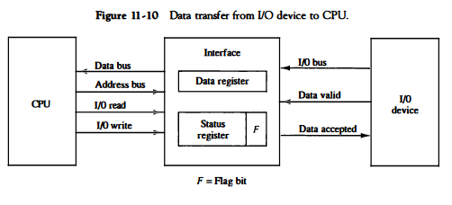
Programmed I/O

Slide 103
Interrupt Initiated I/O
In the programmed I/O CPU stays in program loop until the I/O indicates that it is ready for data transfer.
This is time consuming process since it makes CPU busy needlessly.
This can be avoided by using an interrupt facility.
When the interface determines that device is ready for data transfer, it generates an interrupt request.
Upon detecting external interrupt signal, the CPU momentarily stops the task it is processing.
It then branches to fulfill the I/O request and return to the original task.
Based on the concept of Priority Interrupt.

Slide 104
Direct Memory Access (DMA)
The transfer of data between a fast storage device such as magnetic disk and memory often limited to the speed of CPU.
Removing the CPU and letting the peripheral device manage the memory bus directly improve speed of transfer.
Such transfer technique is called Direct Memory Access (DMA).
A DMA controller takes over the buses to manage the transfer directly between I/O device and memory.
During DMA transfer, the CPU is idle and has no control over memory buses.
By using Bus Request(BR) and Bus Grant(BG) the buses are released to DMA controller.

Slide 105
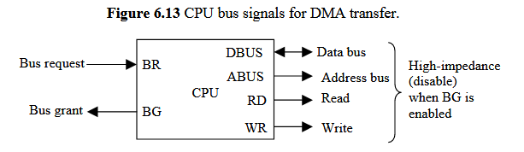
DMA
Data transfer ways:
  Burst Transfer: Here number of words are transferred in a block. Example: Magnetic disk.
  Cycle stealing: Allows the DMA controller to transfer one data word at a time after it must return the control of buses to CPU.

Slide 106
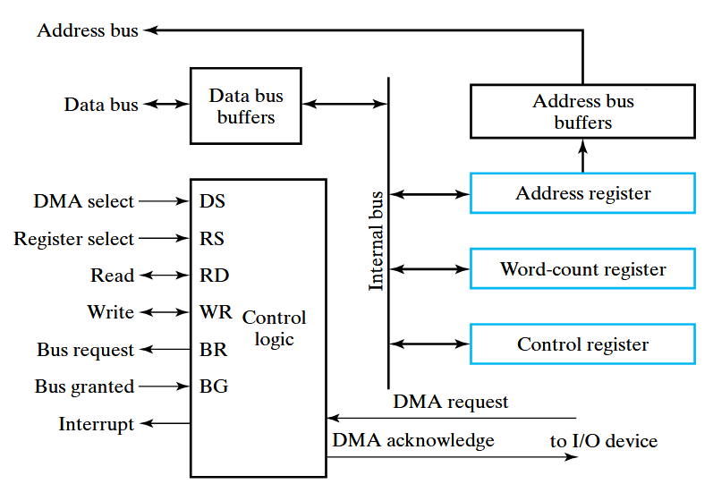
DMA Controller

Slide 107
Initialization of DMA
The CPU initializes the DMA by sending the following information through the data bus.
  The starting address of the memory block where data are available(for read) or where data are to be stored(for write).
  The word count, which is the number of words in the memory block.
  Control to specify the mode of transfer such as read or write.
  A control to start the DMA transfer.

Slide 108
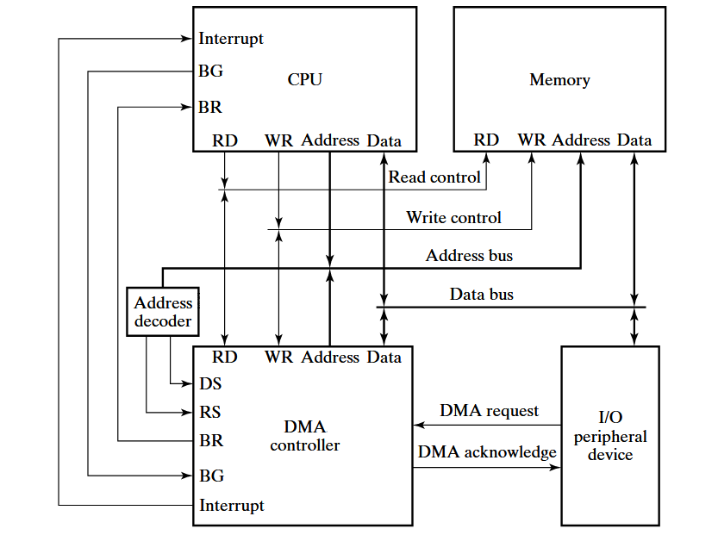
DMA Transfer in a computer system

Slide 109
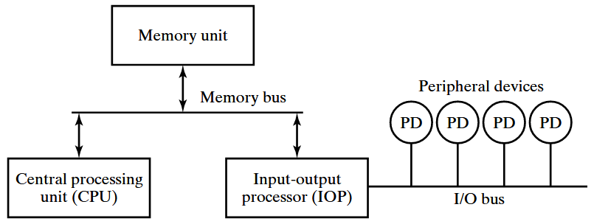
Input-Output Transfer (IOP)

Slide 110
Input-Output Transfer (IOP)
An IOP takes care of input and output tasks.
IOP is similar to CPU except IOP can fetch and execute an I/O instruction.
CPU is usually assigned task of initiating the I/O program and thus IOP.
The CPU is assigned the task of initiating all operations, but I/O instructions are executed in IOP.
When an I/O operation is required, the CPU informs the IOP where to find the I/O program and then leaves the transfer details to the IOP.
CPU instructions also test I/O status conditions needed for making decisions on various I/O activities.
IOP is also responsible of taking care of data synchronization, formats etc between CPU and I/O devices.
In most computers CPU is master and IOP is slave.
The IOP typically asks for CPU attention by means of Interrupt.

Slide 111
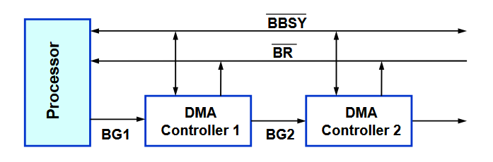
Bus Arbitration
The device that is allowed to initiate data transfers on the bus at any given time is called Bus master.
Bus arbitration is the process by which the next device becomes Bus master and will do the data transfer.
Two approaches: Centralized Arbitration and Distributed Arbitration.
        Centralized Arbitration

Slide 112
Types of Interrupt
Major types of Interrupt are:
  External Interrupt: It comes from I/O devices, from timing device, or from any other external source.
  Internal Interrupt: It includes register overflow, invalid operation code, stack overflow etc.
  Software Interrupt or Hardware Interrupt: External and Internal interrupts are initiated from signals that occur in the hardware of the CPU. A software interrupt is initiated by executing an instruction.
  Priority Interrupt: In case several sources will request service simultaneously, in this case system must decide which device to service first. For ex: Polling, Daisy Chain.

Slide 113
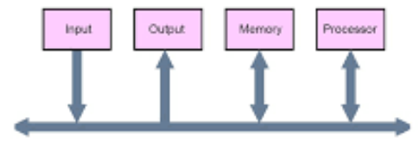
Buses
Data Bus: Bi-directional and transfers data.
Address Bus: Uni-directional and sends the address.
Control Bus: R/W, BR,BG etc.
Bus Structure: Single bus

Slide 114
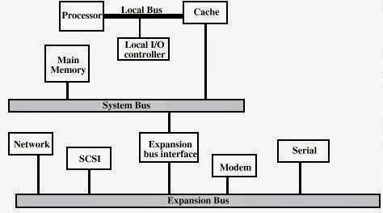
Buses
Bus Structure: Multi bus

Slide 115
Synchronous or Asynchronous Data Transfer
Internal operations in a digital system are synchronized by means of clock pulses supplied by common pulse generator.
If the registers in the interface share a common clock with the CPU registers, the transfer is synchronous.
Asynchronous data transfer requires that control signals be transmitted between communicating units to indicate the time at which data is being transmitted.
Asynchronous data transfer can be accomplished by Strobe & Handshaking.

Slide 116
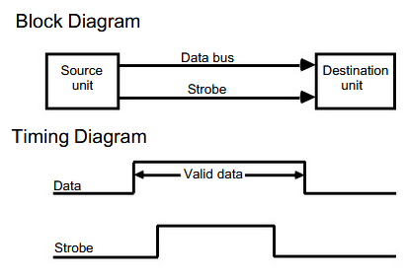
Strobe Control
Strobe control:
  It employs single control line.
  It can be activated either by source or destination unit.

Slide 117
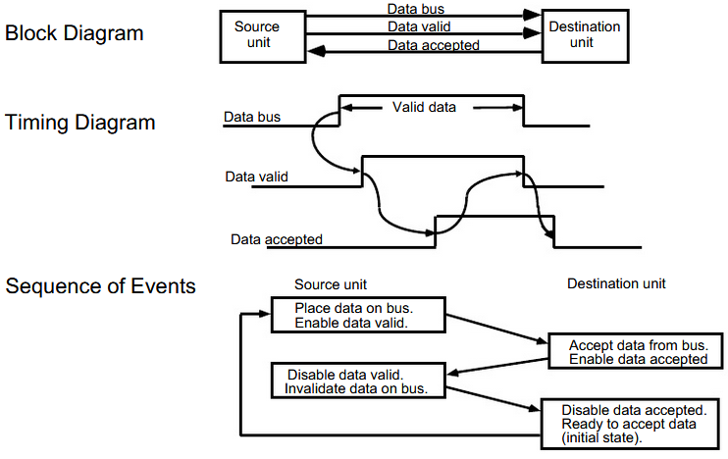
Handshaking

